Slide 1


WELCOME TO
2018
THANK YOU TO ALL OF OUR 2018 SPONSORS!

Slide 2

WELCOME TO
2018
THANK YOU TO ALL OF OUR 2018 SPONSORS!

Slide 3
Articulating
Your Message
with Barbara Carr

Slide 4
Tw0-minute task:
New concept.
Most of these will take more than 2 minutes to fully complete but I’d like to get you started while I’m here to answer questions.
www.FuseMarketingandMedia.com

Slide 5
Start with a plan
(Goal/Objective)
What do you want to accomplish with this message?
www.FuseMarketingandMedia.com

Slide 6
Tw0-minute task:
Make a list of possible objectives for you
www.FuseMarketingandMedia.com

Slide 8
Identify Your ideal audience
www.FuseMarketingandMedia.com

Slide 9
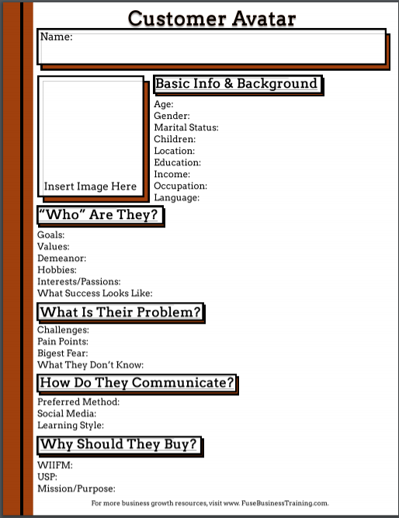

Slide 10
Tw0-minute task:
Who is your ideal audience (your customer avatar)?
www.FuseMarketingandMedia.com

Slide 12
Prepare Your
“Elevator Pitch”
This is also known as a “30 second commercial”
www.FuseMarketingandMedia.com

Slide 13
Tw0-minute task:
What will you say in the elevator?
www.FuseMarketingandMedia.com

Slide 14
Practice your pitch
www.FuseMarketingandMedia.com

Slide 16
Prepare your
“who I really am” conversation
www.FuseMarketingandMedia.com

Slide 17
Tw0-minute task:
What are some topics that will relate to others
and grab the interest or intrigue of others?
www.FuseMarketingandMedia.com

Slide 19
Acknowledge what you can contribute to others
And do so enthusiastically
www.FuseMarketingandMedia.com

Slide 20
Tw0-minute task:
What can you contribute quickly, easily, free?
www.FuseMarketingandMedia.com

Slide 22
Give more than you take
Your message should be about helping others
Not to sell to them
www.FuseMarketingandMedia.com

Slide 23


Slide 24
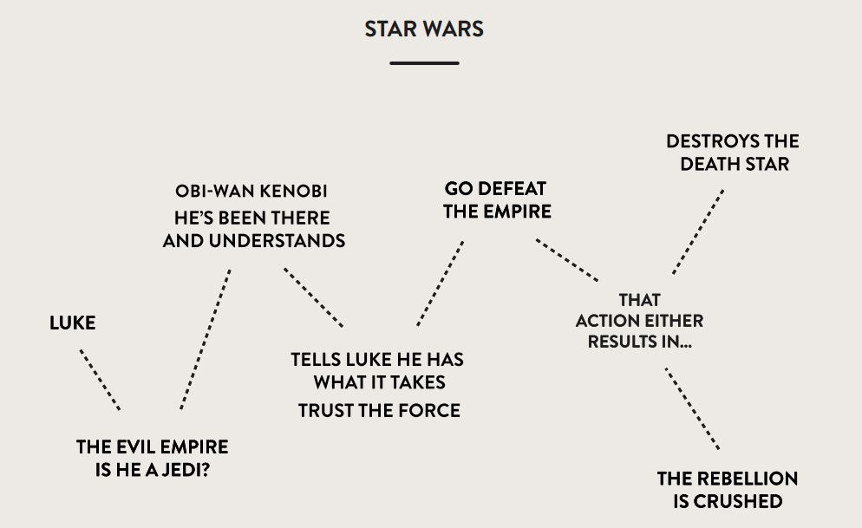

Slide 25
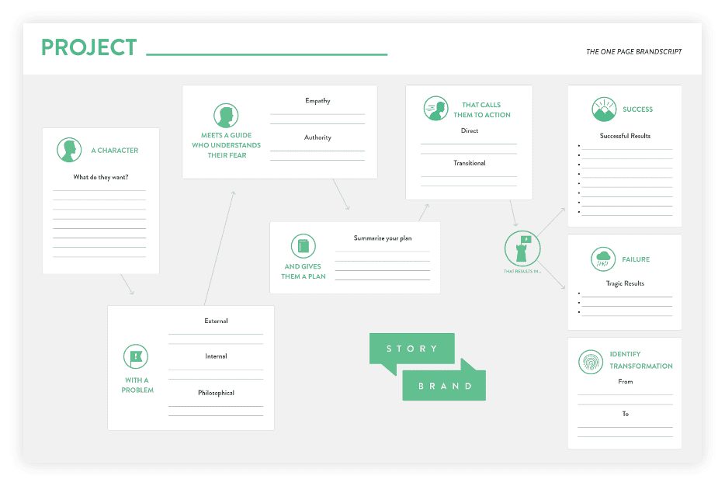
Complete Your StoryBrand at: www.MyStoryBrand.com

Slide 26
Tw0-minute task:
What is your storybrand?
www.FuseMarketingandMedia.com

Slide 28
Follow Up
In the next 24 hours I’ll send to Shari:
Link to the recorded video
Powerpoint slides
Customer avatar worksheet
Link for storybrand
Link for survey (please complete)
www.FuseMarketingandMedia.com

Slide 29


